Slide 1
AutoDJ
Matthew Stock, Steven Sun, Craig Dunton, Nick Bova

Slide 2
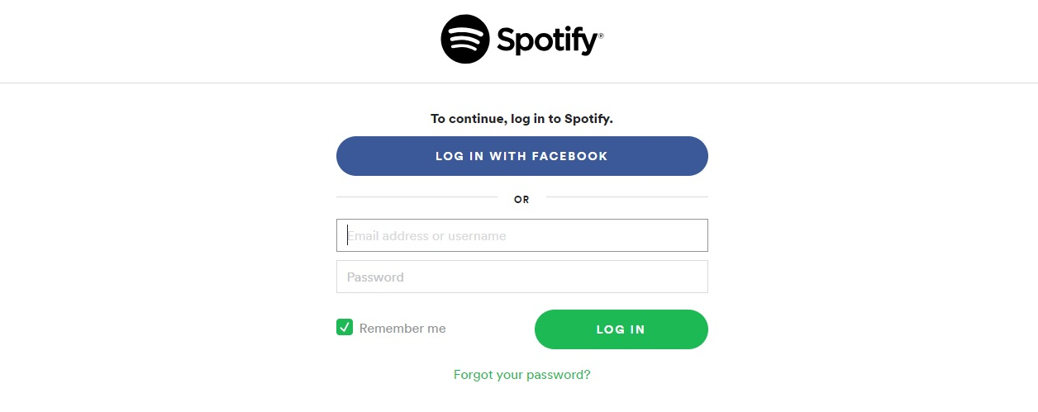
Authentication

Slide 3
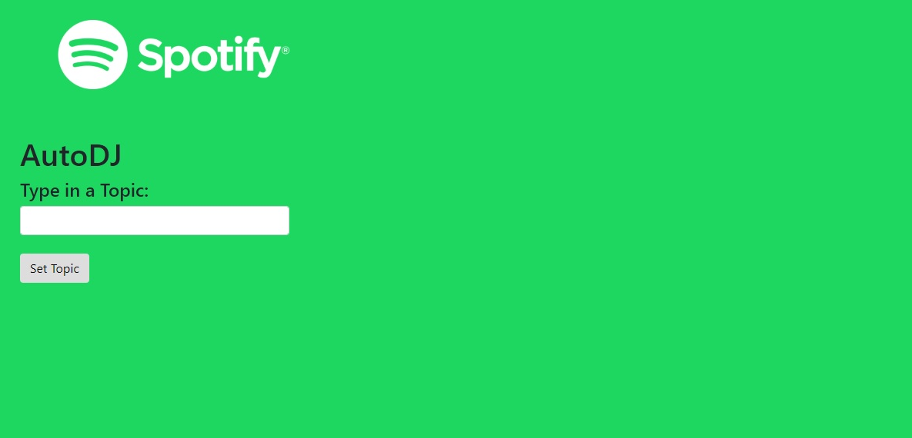
Redirect

Slide 4
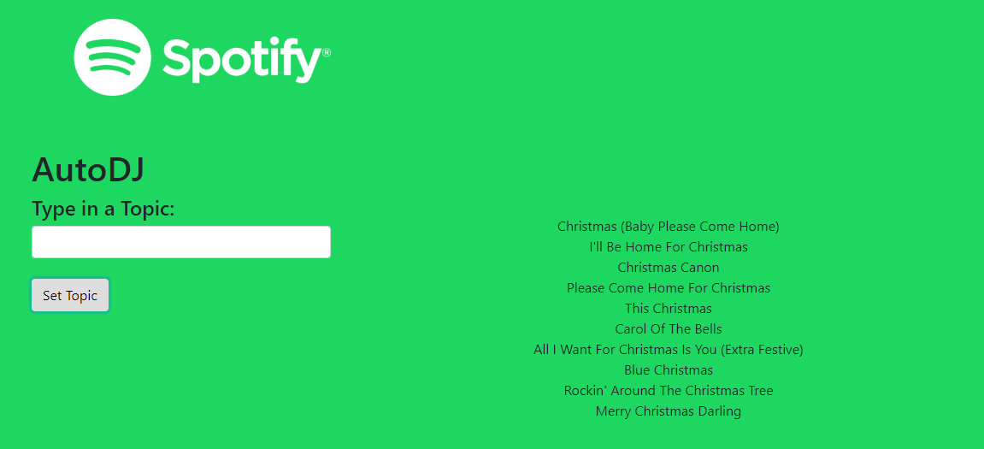
Christmas Search

Slide 5
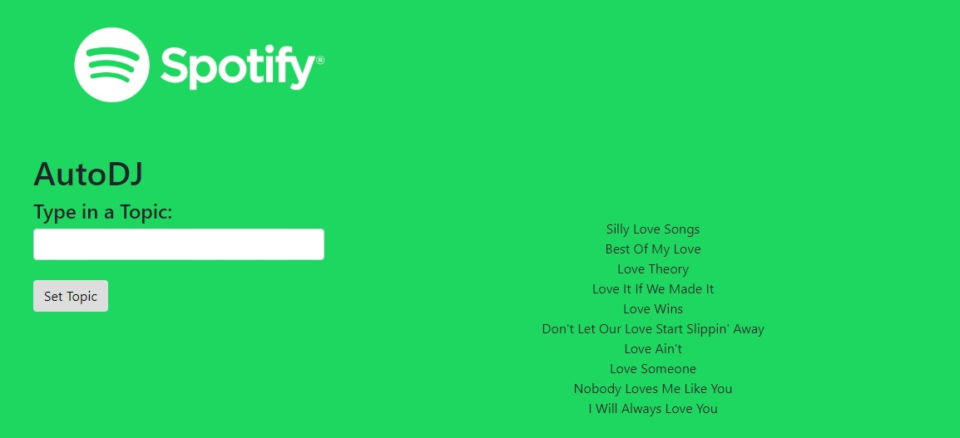
Love Search

Slide 6
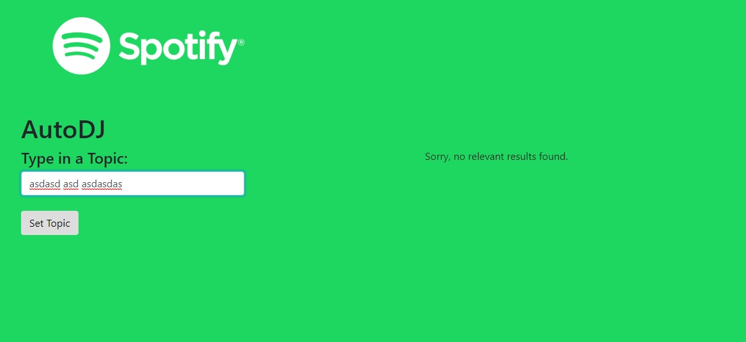
No Results

Slide 7





Questions?

